Slide 1

MINI PROJECT/INTERNSHIP
(KCS - 354P)
Project name:- Covid-19 Tracker
Submitted by:-
Manish Kumar Rai
(CSE-DS)
Roll no:- 2000271540036

Slide 2
INTRODUCTION
Since past 1 and half year the covid-19 pandemic has hits us
very hard .So In this project I had made a website by using
(HTML and CSS ) to make people more aware about the
pandemic how to get themself protected, and to get
themselves registered for vaccination, and to get the live stats
of the Covid-19 that includes the total number of cases,
total active cases and total deaths.

Slide 4
THE TRAINING PROGRAM
For the training I choose the online platform UDEMY.
The course that I selected for my training was
“The Complete web development Bootcamp ”
BY:- DR. Angela Yu.
The duration of the course is 53.5 hours .

Slide 5
THE LANGUAGES USED IN THE PROJECT

Slide 6
WORKING METHODOLOGY
To get the various information about the covid 19
How to get yourself protected, how to get vaccinated card has been made.
To get the live stats of the covid 19 data that includes the total cases, total active cases , total deaths we have used the covid-19-india.org
API. From where the data is updated timely.

Slide 7
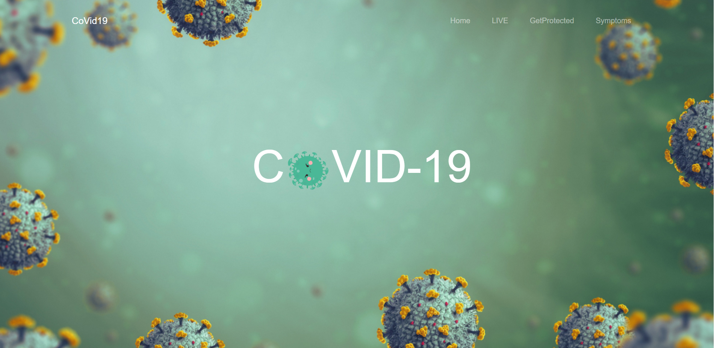
THE HOME PAGE

Slide 8
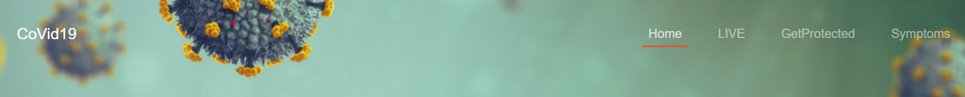
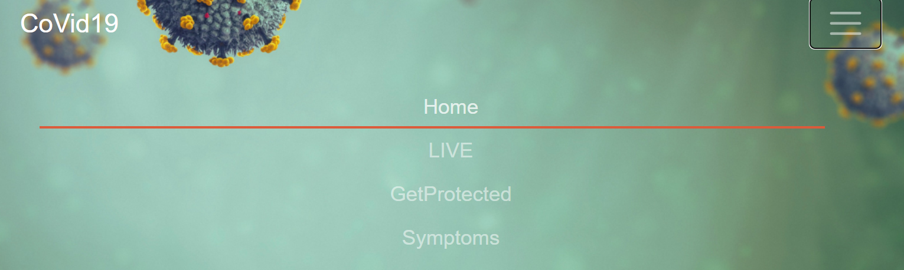
THE NAVBAR

Slide 9
NAVBAR
For making the navbar I have made use of the
“BOOTSTRAPS 4.0” predefined navbar classes
And for making the elements of the navbar I have made
Use of the <li> tag of the HTML.
Since the website is responsive for the mobile screen also
I have used the nav-bar collapse predefined class of the
“bootstraps 4.0” to make a collapsible menu

Slide 10
Navbar underline
To make the underline animation I have used some CSS properties and had used the PSEUDO class :Hover and Pseudo
Element : after
The :after selectors in CSS is used to add content before and after an element. The :hover is pseudo-class and :after are pseudo-elements. In CSS, pseudo-elements are written after pseudo-class.
Syntax:- a:hover::before {
// CSS Property
}
a:hover::after {
// CSS Property
}

Slide 11

THE Heading TEXT

Slide 12
THE HEADING TEXT
The heading text consists of an animation in which the circular image of the covid-19 .
Is under an animation of rotation the CSS property used make this happen is:-
.rotate {
animation: rotation 2s;
}
@keyframes rotation {
from {
transform: rotate(0deg);
}
to {
transform: rotate(359deg);
}
}

Slide 13
.linear{
animation-timing-function: linear;
}
.infinite{
animation-iteration-count: infinite;
}
So here to make the clear rotation I have used 3 class names for the same image tag named as:- rotate, linear and infinite.

Slide 14
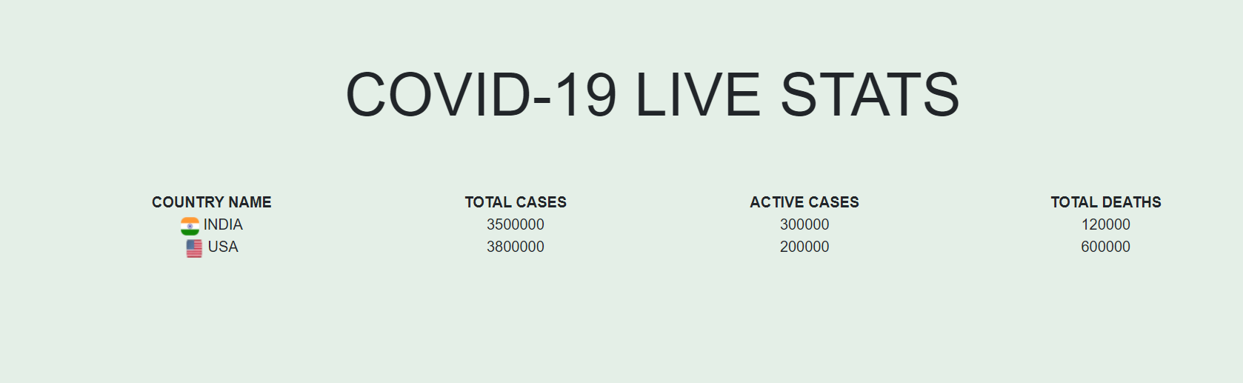
Live Stats Table

Slide 15
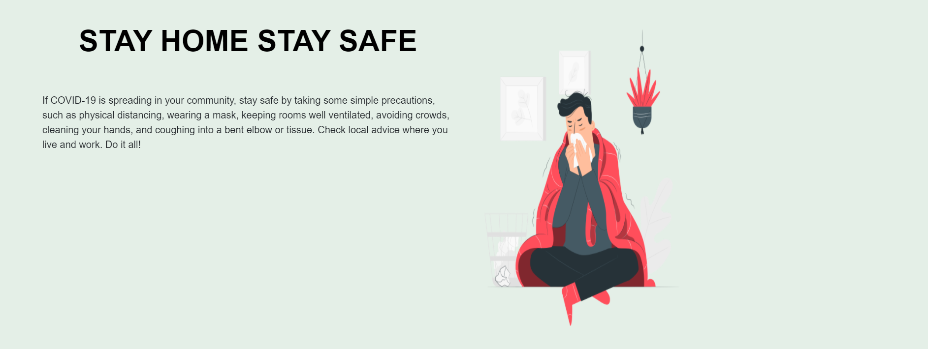
STAY HOME STAY PROTECTED

Slide 16
To make this I have used the bootstraps predefined class “ROWs”
Under which I have used the class “columns” which divide a row into 12 parts to make it half – half used the class col-lg-6
Where the class “lg” means large screen that is for the desktop screen.
To make it to the mobile view have used the class “sm” which means the small screen like mobile phones.

Slide 17
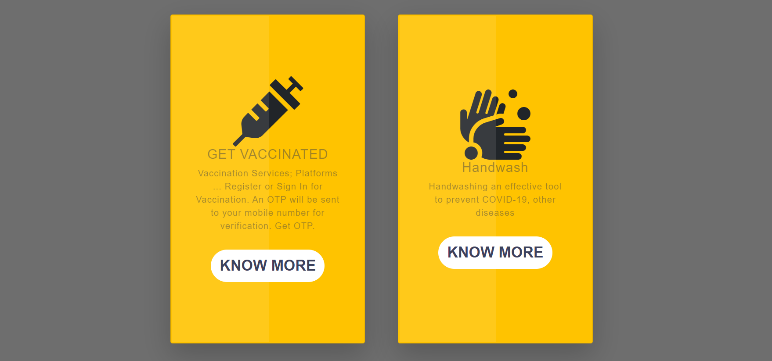
Get Protected

Slide 18
Get Protected

